Slide 1

Data structures using C
Module 3 - Lecture VI
Link Lists
Prepared By
Ms. Smriti Sehgal

Slide 2
Module III – Doubly Link List
Topics to be covered
Introduction
Node Structure
Operations
Insertion
Deletion
Searching
Display

Slide 3
DLL Operations
There are several operations in doubly linked list:
Insertion
Deletion
Searching
Display

Slide 4
DELETION A node can be deleted in three ways 1) After deletion of head node.
2) After deletion of middle node. 3) After deletion of last node.
Original List

Slide 5
1) After deletion of head node.
Algorithm
STEP 1: IF START = NULL
WRITE UNDERFLOW GOTO STEP 6
STEP 2: SET PTR = START
STEP 3: SET START = HEAD → NEXT
STEP 4: SET START → PREV = NULL
STEP 5: FREE PTR
STEP 6: EXIT

Slide 6
Step 1: IF START = NULL
Write UNDERFLOW Go to Step 9 [END OF IF]
Step 2: SET TEMP = START
Step 3: Repeat Step 4 while TEMP -> DATA != ITEM
Step 4: SET TEMP = TEMP -> NEXT
[END OF LOOP]
Step 5: SET PTR = TEMP -> NEXT
Step 6: SET TEMP -> NEXT = PTR -> NEXT
Step 7: SET PTR -> NEXT -> PREV = TEMP
Step 8: FREE PTR
Step 9: EXIT
2) After deletion of middle node.

Slide 7
Step 1: IF START = NULL
Write UNDERFLOW Go to Step 7 [END OF IF]
Step 2: SET TEMP = START
Step 3: REPEAT STEP 4 WHILE TEMP->NEXT != NULL
Step 4: SET TEMP = TEMP->NEXT
[END OF LOOP]
Step 5: SET TEMP ->PREV-> NEXT = NULL
Step 6: FREE TEMP
Step 7: EXIT
3) After deletion of last node.

Slide 8
SEARCHING
Step 1: IF START == NULL
WRITE "UNDERFLOW" GOTO STEP 8 [END OF IF]
Step 2: Set PTR = START
Step 3: Set i = 0
Step 4: Repeat step 5 to 7 while PTR != NULL
Step 5: IF PTR → data = item
return i [END OF IF]
Step 6: i = i + 1
Step 7: PTR = PTR → next
Step 8: Exit

Slide 9
TRAVERSING
Step 1: IF START == NULL
WRITE "UNDERFLOW" GOTO STEP 6 [END OF IF]
Step 2: Set PTR = START
Step 3: Repeat step 4 and 5 while PTR != NULL
Step 4: Write PTR → data
Step 5: PTR = PTR → next
Step 6: Exit

Slide 10
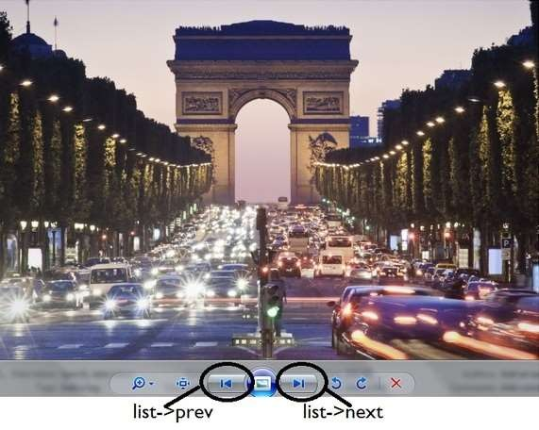
Example of DLL in real world

Slide 11
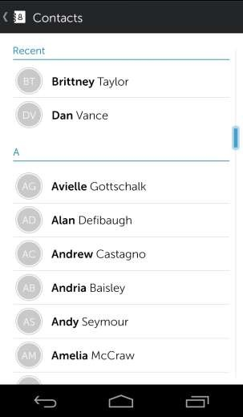
Phonebook
In phonebook the names are sorted in ascending order. If we want to add a new contact then the memory for the new contact is created by linked list.

Slide 12


